Slide 1
CER Policy Agenda 2019-2024
Customer and Society first!
Dr Libor Lochman
Praha, 11 November 2019

Slide 2
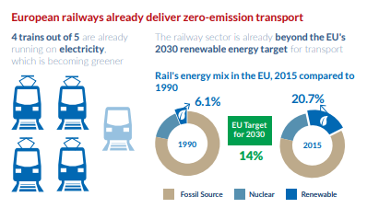
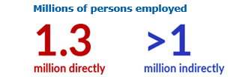
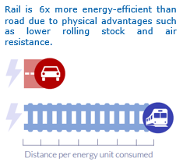
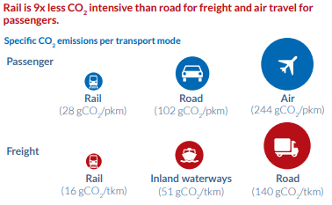
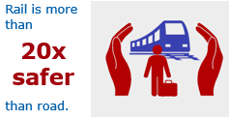
Rail today: creates jobs, is safe, clean, and energy efficient

Slide 3
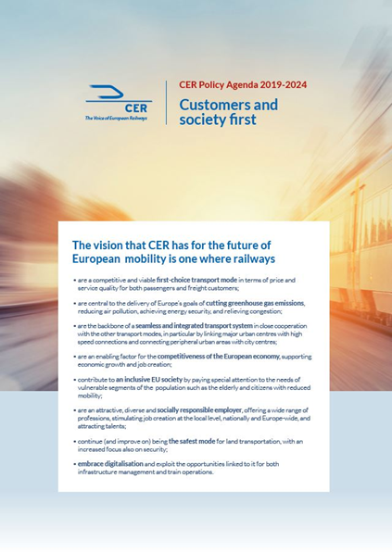
The value of rail for society?
YES!
The most carbon-efficient motorized way to transport
Added value for the whole economy
The safest mode for land transportation

Slide 4
➔ Our Vision
A Union where railways are
a competitive and viable first-choice transport mode for both passengers and freight customers;
continue being the safest mode for land transportation, with an increased focus also on security
central to the delivery of Europe’s goals of cutting greenhouse gas emissions, reducing air pollution and congestion, achieving energy security;
the backbone of a seamless and integrated transport system in close cooperation with the other transport modes;
an enabling factor for the competitiveness of the European economy, supporting economic growth and job creation
and an attractive, diverse and socially responsible employer, and attracting talents;

Slide 5
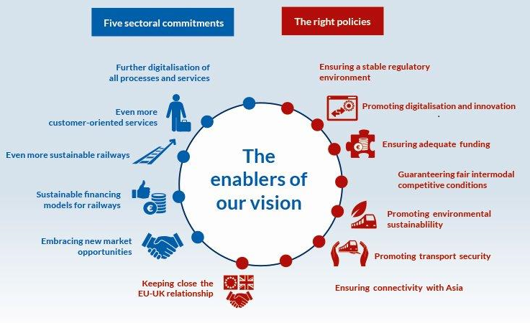
The enablers of our vision

Slide 6
Policy targets – rail specific
No further primary legislation (no 5th rail package; all efforts should be dedicated to a swift implementation of the Technical Pillar of the 4RP
Rail sector’s priorities reflected in the evaluation and possible revision of the TEN-T Regulation and Regulation 913/2010 concerning a European Rail Network for Competitive Freight
An appropriate legal solution for implementing TTR, for example by adapting Annex VII of Directive 2012/34/EU on the schedule for capacity allocation
A strong and increased transport budget for the Connecting Europe Facility in order to complete the TEN-T network and support the digital transformation of operations, including ERTMS deployment on board and on track

Slide 7
Policy targets - multimodal
Defend the 2011 White Paper modal shift targets and a strengthening of the CO2 reduction targets for 2030 (-25%) 2040 (-65%) and 2050 (-100%), compared to 1990
Ensure rail sector’s priorities are reflected in new White Paper (expected for 2021)
Push for a better implementation of user pays and polluter pays principle reflecting the results of the transport costs internalisation study commissioned by DG MOVE
A level playing field between all modes of transport, especially on taxation (energy, VAT, and kerosene ) and the Emissions Trading System (ETS)

Slide 8
Passenger RUs priorities?
1. Integrated and through ticketing
The operational, legal and commercial frameworks under the development
Directive 2016/2370 requires railway undertakings to establish EU-wide through-ticketing systems by 2021 (report of the Commission due in 2022) !!!
2. Rail Passenger Rights Regulation
Currently in revision by European legislators
Discussion on new provisions for
  Exemptions
  Through-Tickets
  Assistance of Persons with reduced mobility
  delay compensation thresholds
  Rerouting of stranded passengers
  bike carriage…

Slide 9
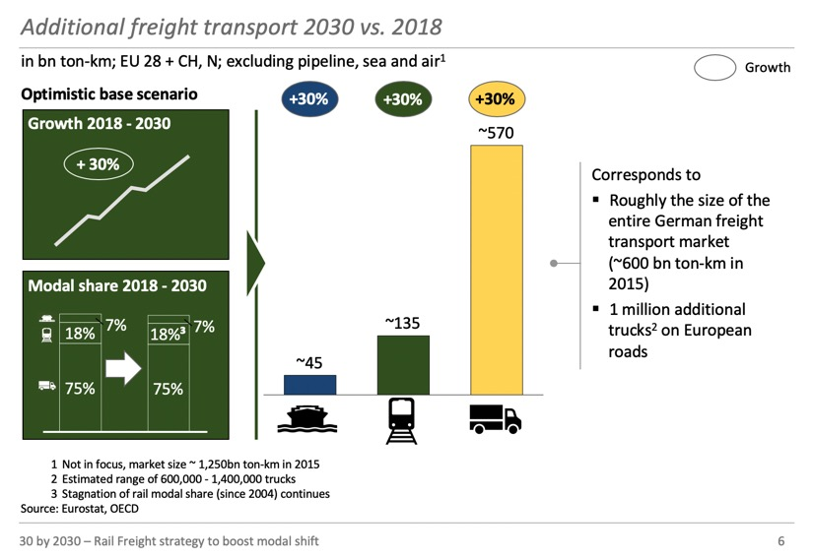
Freight? The road traffic growth is not sustainable!

Slide 10
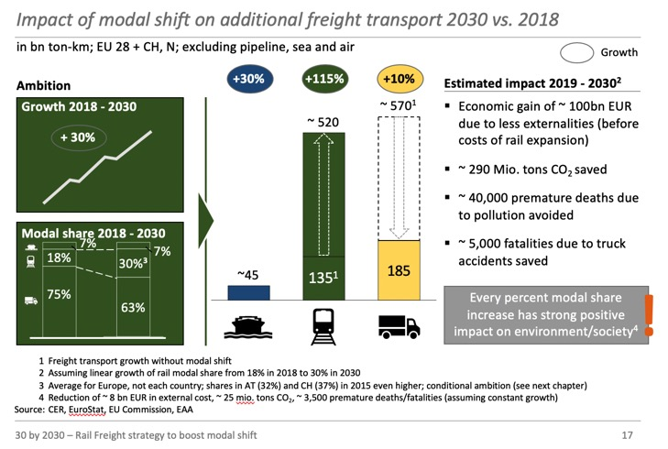
Solution? Rail freight!

Slide 11
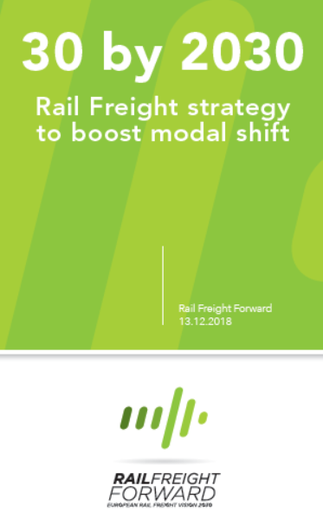
How? Let’s work together:
RUs put in place new service models
RUs offer transport and logistics solutions across borders and across modes
Governments ensure rail infrastructure funding
EU and Governments guarantee a level playing field between transport modes

Slide 12
Thank you
Dr Libor Lochman
Executive Director
libor.lochman@cer.be

